Slide 1

CSE 411: Artificial Intelligence
Topic - 2: Intelligent Agents
Department of CSE
Daffodil International University
Notes:
‹#›

Slide 2
Topic Contents
Agents and Environments
Good Behavior: The Concept of Rationality
The Nature of Environments
The Structure of Agents
Notes:
‹#›

Slide 3

Intelligent Agent
An agent
perceives its environment with sensors and
acts upon that environment with its actuators.
An agent gets percepts one at a time, and maps this percept sequence to actions.
‹#›

Slide 4
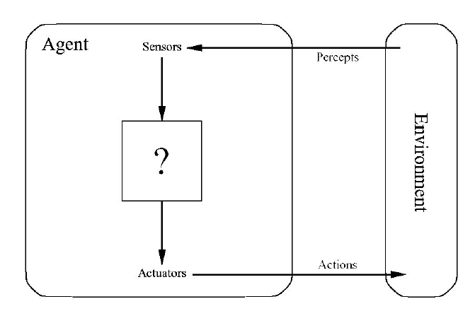
An Agent
‹#›
Notes:
‹#›

Slide 5
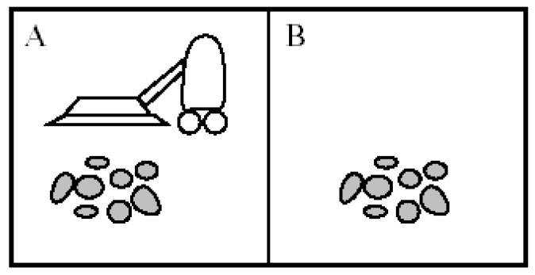
Example of an Agent
Let us consider a vacuum-cleaner agent that is shown in the figure below.
The vacuum-cleaner world has just two locations: squares A and B.
‹#›

Slide 6
Example of an Agent
The vacuum agent perceives which square it is in and whether there is dirt in the square.
It can choose to move left, move right, suck up the dirt, or do nothing.
One very simple agent function is the following: if the current square is dirty, then suck; otherwise, move to the other square.
‹#›

Slide 7
Example of an Agent
Environment: squares A and B
Percepts: [location, status], e.g. [A, Dirty]
Actions: left, right, suck, and no-op
‹#›

Slide 8
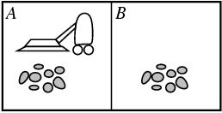
Example of an Agent
function REFLEX-VACUUM-AGENT ([location, status]) return an action
if status == Dirty then return Suck
else if location == A then return Right
else if location == B then return Left

Slide 9
Rational Agent
For each possible percept sequence, a rational agent should select an action (using an agent function) that is expected to maximize its performance measure, given the evidence provided by the percept sequence and whatever built-in prior knowledge the agent has.
A percept sequence is the complete history of anything the agent has ever perceived.
A performance measure is a means of calculating how well the agent has performed based on the sequence of percepts that it has received.
An agent’s prior knowledge of the environment is the knowledge that the agent designer has given to the agent before its introduction to the environment.
‹#›

Slide 10
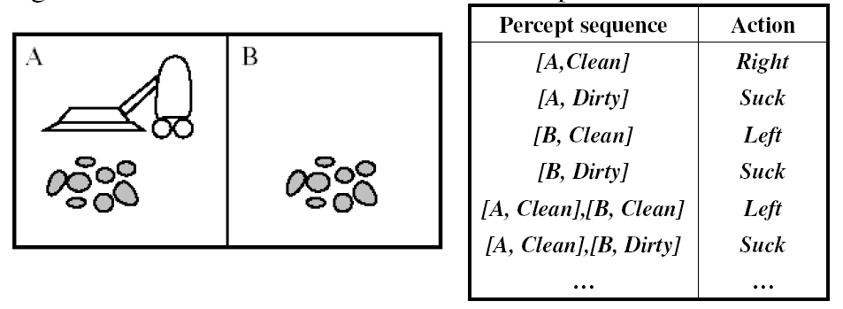
Rational Agent
An agent's behavior is described by the agent function that maps percept sequences to actions.
f : seq(P) →A
Agent function for vacuum cleaner example:
‹#›

Slide 11
Task Environments
To design a rational agent we must specify its task environment:
Performance Measures
Environment
Actuators
Sensors
used to evaluate how well an agent solves the task at hand
surroundings beyond the control of the agent
used by the agent to perform actions
provide information about the current state of the environment
‹#›

Slide 12
Example
PEAS description of the environment for an automated taxi:
Performance
Safety, destination, profits, legality, comfort
Environment
Streets/motorways, other traffic, pedestrians, weather
Actuators
Steering, accelerator, brake, horn, speaker/display
Sensors
Video, sonar, speedometer, engine sensors, keyboard, GPS
‹#›

Slide 13
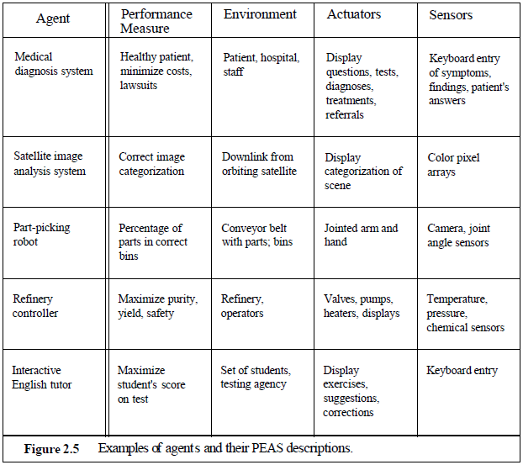
Example…
Md. Tarek Habib
‹#›

Slide 14
Environment Types
The environment for an agent may be
Fully or partially observable
Deterministic or stochastic
Episodic or sequential
Static or dynamic
Discrete or continuous
Single or multi-agent
‹#›

Slide 15
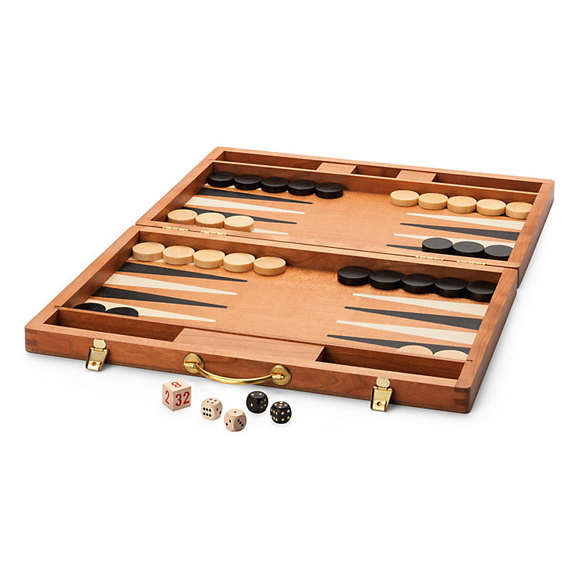
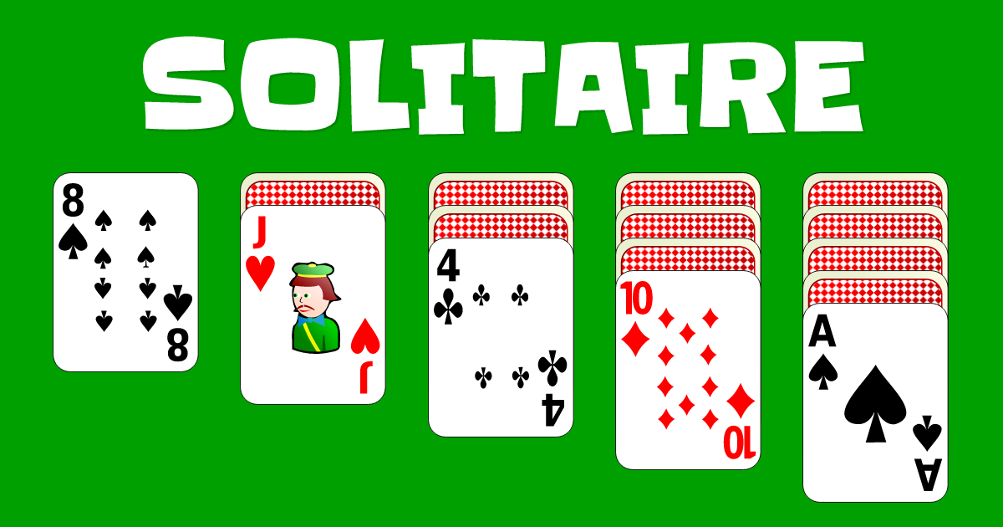
Environment Types
Backgammom
Solitaire
‹#›
Notes:
‹#›

Slide 16
Environment Types
 | Solitaire | Backgammom | Internet shopping | Taxi
Observable??
Deterministic??
Episodic??
Static??
Discrete??
Single-agent??
‹#›

Slide 17
Environment Types
Fully vs. partially observable: an environment is full observable when the sensors can detect all aspects that are relevant to the choice of action.
 | Solitaire | Backgammom | Internet shopping | Taxi
Observable??
Deterministic??
Episodic??
Static??
Discrete??
Single-agent??
‹#›
Notes:
‹#›
Volledige observeerbare omgevingen zijn handig omdat de agent geen
Interne staat moet bijhouden over de omgeving
Partieel observeerbare omgevingen door noise of niet goed afgestelde sensoren of ontbrekende informatie

Slide 18
Environment Types
Fully vs. partially observable: an environment is full observable when the sensors can detect all aspects that are relevant to the choice of action.
 | Solitaire | Backgammom | Internet shopping | Taxi
Observable?? | FULL | FULL | PARTIAL | PARTIAL
Deterministic??
Episodic??
Static??
Discrete??
Single-agent??
‹#›

Slide 19
Environment Types
Deterministic vs. stochastic: if the next environment state is completely determined by the current state the executed action then the environment is deterministic.
 | Solitaire | Backgammom | Internet shopping | Taxi
Observable?? | FULL | FULL | PARTIAL | PARTIAL
Deterministic??
Episodic??
Static??
Discrete??
Single-agent??
‹#›
Notes:
‹#›
Als de omgeving gedeeltelijk observeerbaar is kan deze stochastisch lijken.
Dus het is beter om te kijken of de omgebing determinitisch of stochastisch is vanuit het standpunt van de agent.
Als de omgeving deterministisch is behalve de acties van de andere agenten dan is de omgeving strategisch.

Slide 20
Environment Types
Deterministic vs. stochastic: if the next environment state is completely
determined by the current state the executed action then the environment is deterministic.
 | Solitaire | Backgammom | Internet shopping | Taxi
Observable?? | FULL | FULL | PARTIAL | PARTIAL
Deterministic?? | YES | NO | YES | NO
Episodic??
Static??
Discrete??
Single-agent??
‹#›
Notes:
‹#›

Slide 21
Environment Types
Episodic vs. sequential: In an episodic environment the agent’s experience can be divided into atomic steps where the agents perceives and then performs a single action. The choice of action depends only on the episode itself.
 | Solitaire | Backgammom | Internet shopping | Taxi
Observable?? | FULL | FULL | PARTIAL | PARTIAL
Deterministic?? | YES | NO | YES | NO
Episodic??
Static??
Discrete??
Single-agent??
‹#›
Notes:
‹#›

Slide 22
Environment Types
Episodic vs. sequential: In an episodic environment the agent’s experience can be divided into atomic steps where the agents perceives and then performs a single action. The choice of action depends only on the episode itself
 | Solitaire | Backgammom | Internet shopping | Taxi
Observable?? | FULL | FULL | PARTIAL | PARTIAL
Deterministic?? | YES | NO | YES | NO
Episodic?? | NO | NO | NO | NO
Static??
Discrete??
Single-agent??
‹#›
Notes:
‹#›

Slide 23
Environment Types
Static vs. dynamic: If the environment can change while the agent is choosing an action, the environment is dynamic. Semi-dynamic if the agent’s performance changes even when the environment remains the same.
 | Solitaire | Backgammom | Internet shopping | Taxi
Observable?? | FULL | FULL | PARTIAL | PARTIAL
Deterministic?? | YES | NO | YES | NO
Episodic?? | NO | NO | NO | NO
Static??
Discrete??
Single-agent??
‹#›
Notes:
‹#›
If the agent performance score changes ahen time passes, the environment is semi-dynamic.

Slide 24
Environment Types
Static vs. dynamic: If the environment can change while the agent is choosing an action, the environment is dynamic. Semi-dynamic if the agent’s performance changes even when the environment remains the same.
 | Solitaire | Backgammom | Internet shopping | Taxi
Observable?? | FULL | FULL | PARTIAL | PARTIAL
Deterministic?? | YES | NO | YES | NO
Episodic?? | NO | NO | NO | NO
Static?? | YES | YES | SEMI | NO
Discrete??
Single-agent??
‹#›
Notes:
‹#›
If the agent performance score changes ahen time passes, the environment is semi-dynamic.

Slide 25
Environment Types
Discrete vs. continuous: This distinction can be applied to the state of the
environment, the way time is handled and to the percepts/actions of the agent.
 | Solitaire | Backgammom | Internet shopping | Taxi
Observable?? | FULL | FULL | PARTIAL | PARTIAL
Deterministic?? | YES | NO | YES | NO
Episodic?? | NO | NO | NO | NO
Static?? | YES | YES | SEMI | NO
Discrete??
Single-agent??
‹#›
Notes:
‹#›
If the agent performance score changes ahen time passes, the environment is semi-dynamic.

Slide 26
Environment Types
Discrete vs. continuous: This distinction can be applied to the state of the
environment, the way time is handled and to the percepts/actions of the agent.
 | Solitaire | Backgammom | Internet shopping | Taxi
Observable?? | FULL | FULL | PARTIAL | PARTIAL
Deterministic?? | YES | NO | YES | NO
Episodic?? | NO | NO | NO | NO
Static?? | YES | YES | SEMI | NO
Discrete?? | YES | YES | YES | NO
Single-agent??
‹#›
Notes:
‹#›
If the agent performance score changes ahen time passes, the environment is semi-dynamic.

Slide 27
Environment Types
Single vs. multi-agent: Does the environment contain other agents who are also maximizing some performance measure that depends on the current agent’s actions?
 | Solitaire | Backgammom | Internet shopping | Taxi
Observable?? | FULL | FULL | PARTIAL | PARTIAL
Deterministic?? | YES | NO | YES | NO
Episodic?? | NO | NO | NO | NO
Static?? | YES | YES | SEMI | NO
Discrete?? | YES | YES | YES | NO
Single-agent?? | YES | NO | NO | NO
‹#›
Notes:
‹#›
If the agent performance score changes ahen time passes, the environment is semi-dynamic.

Slide 28
Environment Types
The simplest environment is
Fully observable, deterministic, episodic, static, discrete and single-agent.
Most real situations are:
Partially observable, stochastic, sequential, dynamic, continuous and multi-agent.
‹#›

Slide 29
Agent Types
Four basic kinds of agent that embody the principles underlying almost all intelligent systems:
Simple reflex agents;
Model-based reflex agents;
Goal-based agents; and
Utility-based agents.
‹#›

Slide 30
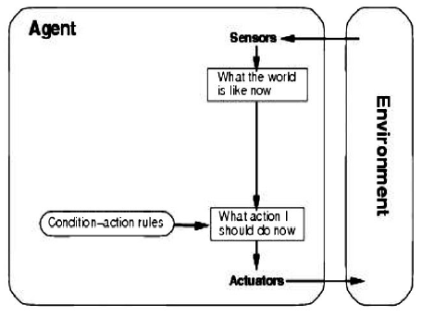
Agent Types: Simple Reflex
Select action on the basis of only the current percept,
e.g. the vacuum-agent
Large reduction in possible percept/action situations
Implemented through condition-action rules
if dirty then suck
Example:
Agent: Mail sorting robot
Environment: Conveyor belt of letters
Rule: e.g.
city = Edin → put Scotland bag
‹#›

Slide 31
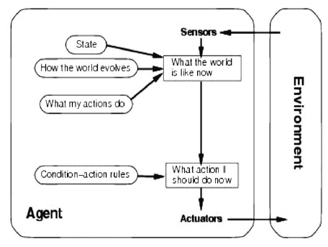
Agent Types: Model-Based
To tackle partially observable environments
Maintain internal state that depends on percept history
Over time update state using world knowledge
How does the world change independently
How do actions affect the world
Example:
Agent: Robot vacuum cleaner
Environment: Dirty room, furniture
Model: Map of room, which areas already cleaned
‹#›

Slide 32
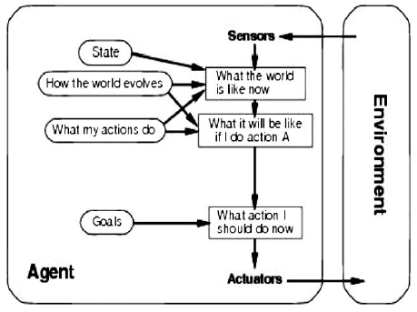
Agent Types: Goal-Based
The agent needs a goal to know which situations are desirable
Difficulties arise when long sequences of actions are required to find the goal
Typically investigated in search and planning research
Major difference: future is taken into account
Example:
Agent: Robot maid
Environment: House and people
Goal: Clean clothes, tidy room, table laid, etc
‹#›

Slide 33
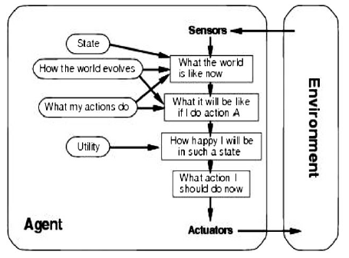
Agent Types: Utility-Based
Certain goals can be reached in different ways
Some are better: have a higher utility
Utility function maps a (sequence of) state(s) onto a real number
Improves on goals:
Selecting between conflicting goals
Selecting between several goals based on likelihood of success and importance of goals
Example:
Agent: Mars Lander
Environment: The surface of mars with obstacles
Utility: Shortest and obstacle-free path
‹#›

Slide 34

THANKS…

